Slide 1
System Programming
Chih-Hung Wang
Chapter 2: Assembler (Part-1)
參考書目
Leland L. Beck, System Software: An Introduction to Systems Programming (3rd), Addison-Wesley, 1997.

Slide 2
Role of Assembler
Assembler
Object
Code
Linker
Source
Program
Executable
Code
Loader

Slide 3
Chapter 2 -- Outline
Basic Assembler Functions
Machine-dependent Assembler Features
Machine-independent Assembler Features
Assembler Design Options

Slide 4
Introduction to Assemblers
Fundamental functions
Translating mnemonic operation codes to their machine language equivalents
Assigning machine addresses to symbolic labels
Machine dependency
Different machine instruction formats and codes

Slide 5
Example Program (Fig. 2.1)
Purpose
Reads records from input device (code F1)
Copies them to output device (code 05)
At the end of the file, writes EOF on the output device, then RSUB to the operating system
Program (See Fig. 2.1)

Slide 6
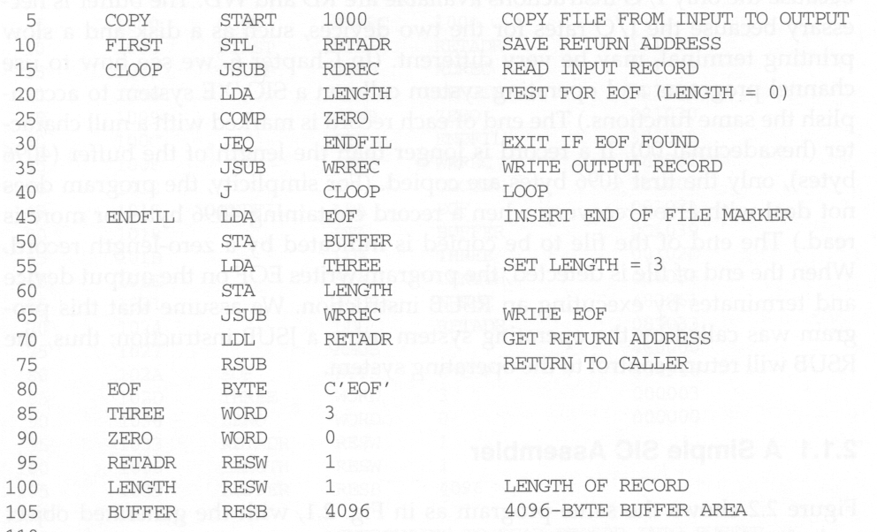
SIC Assembly Program (Fig. 2.1)
Line numbers
(for reference)
Mnemonic opcode
Address labels
comments
operands

Slide 7
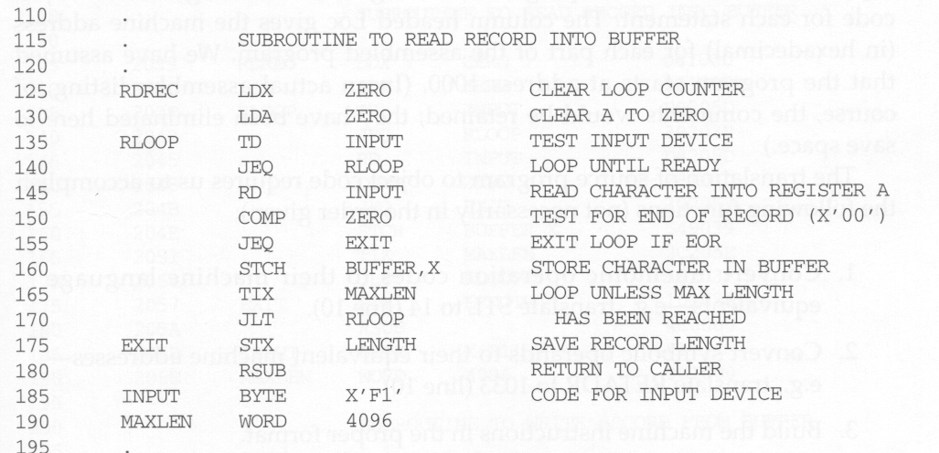
SIC Assembly Program (Fig. 2.1)
Indicate comment lines
Index addressing

Slide 8
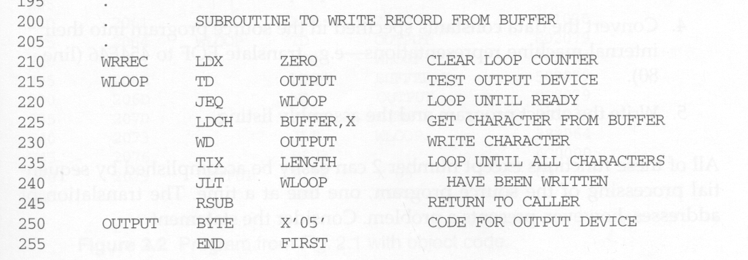
SIC Assembly Program (Fig. 2.1)

Slide 9
Example Program (Fig. 2.1)
Data transfer (RD, WD)
a buffer is used to store record
buffering is necessary for different I/O rates
the end of each record is marked with a null character (00₁₆)
the end of the file is indicated by a zero-length record
Subroutines (JSUB, RSUB)
RDREC, WRREC
save link register first before nested jump

Slide 10
Assembler Directives
Pseudo-Instructions
Not translated into machine instructions
Providing information to the assembler
Basic assembler directives
START :
Specify name and starting address for the program
END :
Indicate the end of the source program, and (optionally) the first executable instruction in the program.
BYTE :
Generate character or hexadecimal constant, occupying as many bytes as needed to represent the constant.
WORD :
Generate one-word integer constant
RESB :
Reserve the indicated number of bytes for a data area
RESW :
Reserve the indicated number of words for a data area

Slide 11
Object Program
Header
Col. 1 H
Col. 2~7 Program name
Col. 8~13 Starting address (hex)
Col. 14-19 Length of object program in bytes (hex)
Text
Col.1 T
Col.2~7 Starting address in this record (hex)
Col. 8~9 Length of object code in this record in bytes (hex)
Col. 10~69 Object code (69-10+1)/6=10 instructions
End
Col.1 E
Col.2~7 Address of first executable instruction (hex)
(END program_name)

Slide 12
Fig. 2.3 (Object Program)
1033-2038: Storage reserved by the loader

Slide 13
Assembler Tasks
The translation of source program to object code requires us the accomplish the following functions:
Convert mnemonic operation codes to their machine language equivalents (e.g. translate STL to 14 - Line 10)
Convert symbolic operands to their equivalent machine addresses format (e.g. translate RETARD to 1033 - Line 10)
Build machine instructions in the proper format
Convert the data constants specified in the source program into their internal machine representations (e.g. translate EOF to 454F46) - Line 80
Write object program and the assembly listing

Slide 14
Example of Instruction Assemble
STCH BUFFER,X
549039
Forward reference
(54)₁₆ 1 (001)₂ (039)₁₆

Slide 15
Forward Reference
A reference to a label (RETADR) that is defined later in the program
Solution
Two passes
First pass: does little more than scan the source program for label definition and assign addresses (such as those in the Loc column in Fig. 2.2).
Second pass: performs most of the actual instruction translation previously defined.

Slide 16
Difficulties: Forward Reference
Forward reference: reference to a label that is defined later in the program.
Loc Label Operator Operand
1000 FIRST STL RETADR
1003 CLOOP JSUB RDREC
… … … … …
1012 J CLOOP
… … … … …
1033 RETADR RESW 1

Slide 17
Two Pass SIC Assembler
Pass 1 (define symbols)
Assign addresses to all statements in the program
Save the addresses assigned to all labels for use in Pass 2
Perform assembler directives, including those for address assignment, such as BYTE and RESW
Pass 2 (assemble instructions and generate object program)
Assemble instructions (generate opcode and look up addresses)
Generate data values defined by BYTE, WORD
Perform processing of assembler directives not done during Pass 1
Write the object program and the assembly listing

Slide 18
Two Pass SIC Assembler
Read from input line
LABEL, OPCODE, OPERAND
Source
program
Intermediate
file
Object
codes
Pass 1
Pass 2
OPTAB
SYMTAB
SYMTAB

Slide 19
Assembler Data Structures
Operation Code Table (OPTAB)
Symbol Table (SYMTAB)
Location Counter (LOCCTR)
OPTAB
Pass 1
Intermediate file
Object Program
Source
Pass 2
LOCCTR
SYMTAB

Slide 20
Location Counter (LOCCTR)
A variable that is used to help in the assignment of addresses, i.e., LOCCTR gives the address of the associated label.
LOCCTR is initialized to be the beginning address specified in the START statement.
After each source statement is processed during pass 1, the length of assembled instruction or data area to be generated is added to LOCCTR.

Slide 21
Operation Code Table (OPTAB)
Contents:
Mnemonic operation codes (as the keys)
Machine language equivalents
Instruction format and length
Note: SIC/XE has instructions of different lengths
During pass 1:
Validate operation codes
Find the instruction length to increase LOCCTR
During pass 2:
Determine the instruction format
Translate the operation codes to their machine language equivalents
Implementation: a static hash table (entries are not normally added to or deleted from it)
Hash table organization is particularly appropriate

Slide 22
SYMTAB
COPY 1000
FIRST 1000
CLOOP 1003
ENDFIL 1015
EOF 1024
THREE 102D
ZERO 1030
RETADR 1033
LENGTH 1036
BUFFER 1039
RDREC 2039
Contents:
Label name
Label address
Flags (to indicate error conditions)
Data type or length
During pass 1:
Store label name and assigned address (from LOCCTR) in SYMTAB
During pass 2:
Symbols used as operands are looked up in SYMTAB
Implementation:
a dynamic hash table for efficient insertion and retrieval
Should perform well with non-random keys (LOOP1, LOOP2).

Slide 23
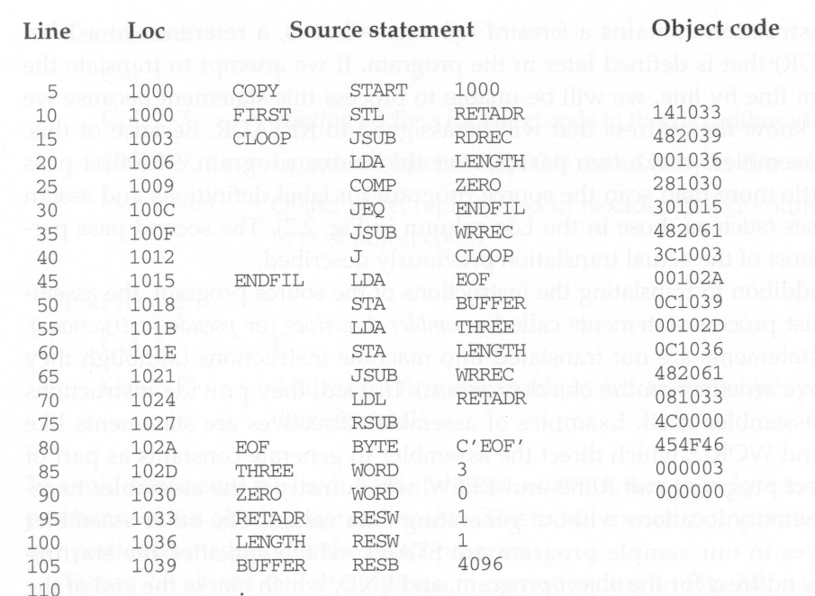
Fig. 2.2 (1) Program with Object code

Slide 24
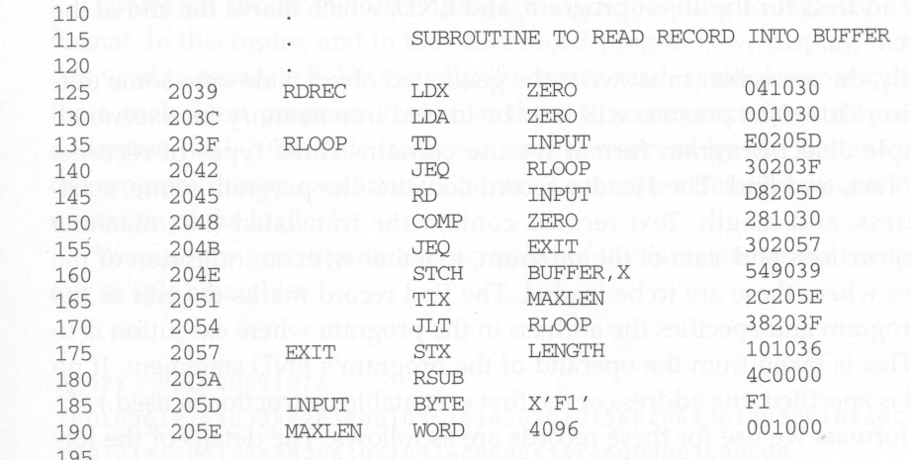
Fig. 2.2 (2) Program with Object code

Slide 25
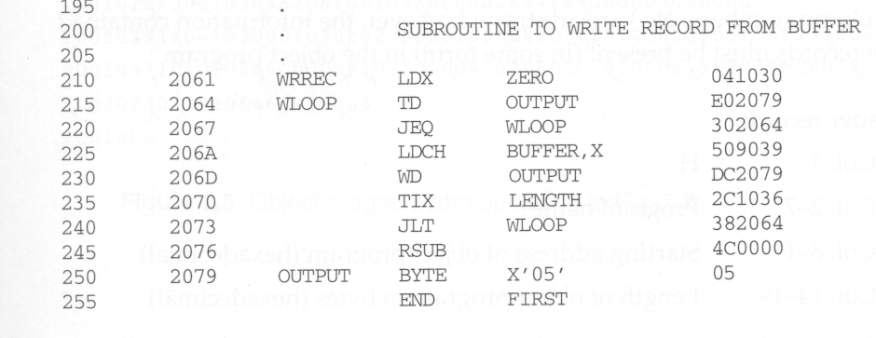
Fig. 2.2 (3) Program with Object code

Slide 26
Figure 2.1 (Pseudo code Pass 1)

Slide 27
Figure 2.1 (Pseudo code Pass 1)

Slide 28
Figure 2.1 (Pseudo code Pass 2)

Slide 29
Figure 2.1 (Pseudo code Pass 2)

